Slide 1
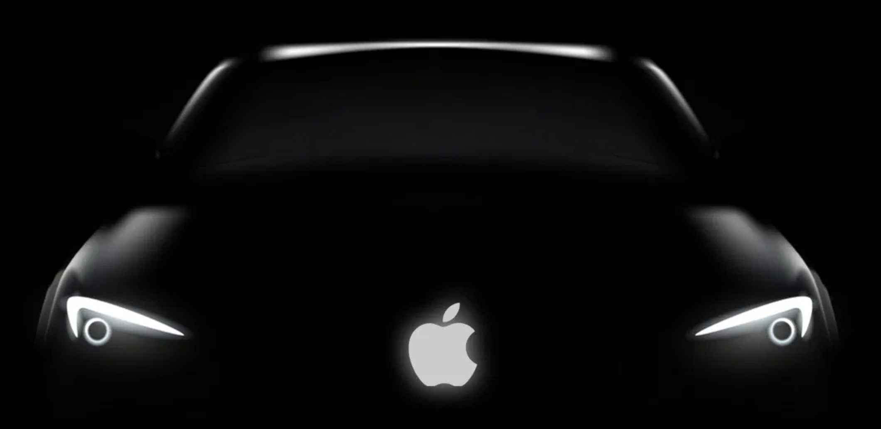
Apple Car

Slide 2


Hello!
We are Samah & Maremar
You can find us on
samah@qusra.net
marysamara2001@gmail.com

Slide 3
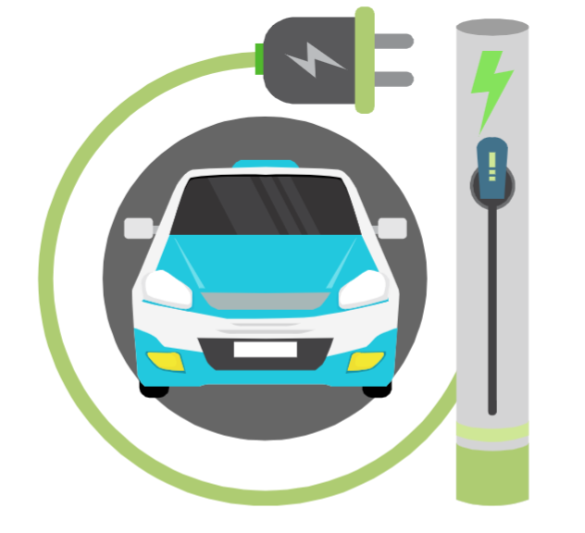
Introduction
The problem
The Idea

Slide 4
What about Electric Cars?
No pollute
Efficiency
Go green
Save money

Slide 5
APPLE CAR
What’s the difference?

Slide 6
Feasibility Study of Apple Car project
Technical
Is the project possible with current technology?
Availability of the technology.
Economic
Is the project possible, given resource constraints?
What are the benefits?
What are the development and operational costs?

Slide 7
Cost - Benefit analysis
Start Up
List the equipment, supplies, services, and assets (like cash) that Apple will need before it can start their business.
Sales Forecast
Calculate how much Apple might earn, depending on how much product it can sell in a year.
Income Projection Statement
Pick up the Gross Profit from the Sales Forecast. Apple will then add their Controllable and Fixed expenses, to come up with a Net Profit.

Slide 8
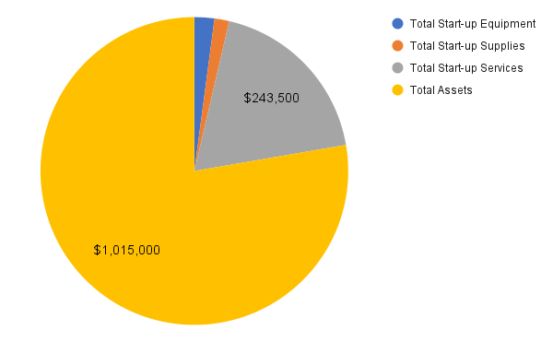
Start Up Plan
$ 27,410
$ 20,230

Slide 9
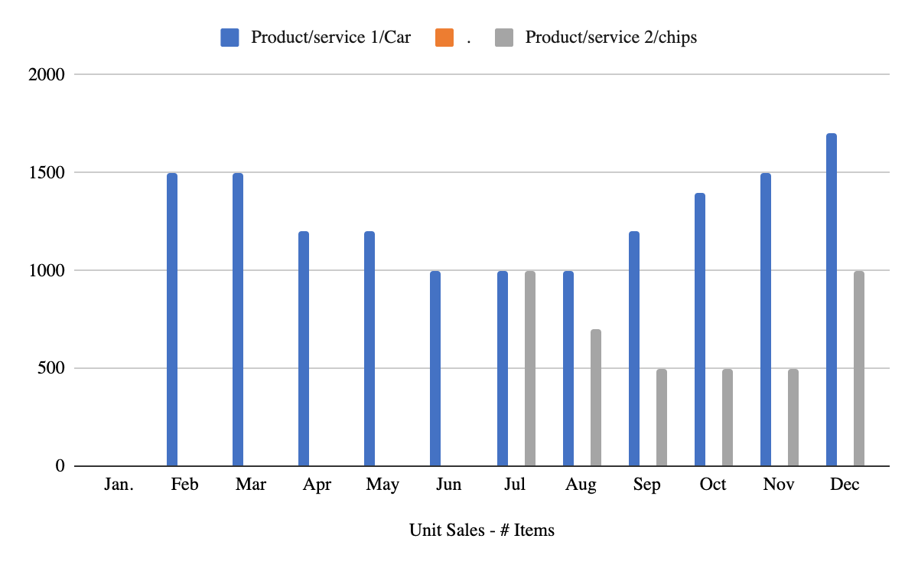
Sales Forecast
Unit Sales - # Items | Total
Car | 14200
chips | 4200

Slide 10
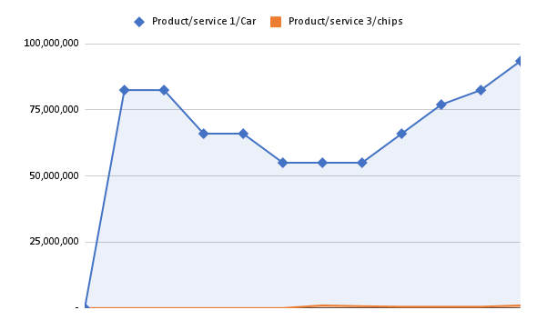
Sales Forecast
Gross Sales | Total
Product/service 1/Car | 781,000,000
Product/service 2/chips | 4,200,000
Unit Prices (Averages)
Product/service 1/Car | $ 55,000
Product/service 2/chips | $ 1,000
Gross Sales within a year.

Slide 11
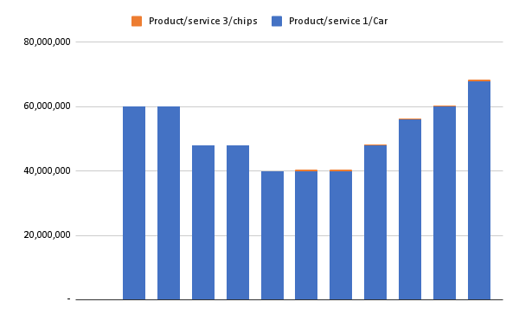
Sales Forecast
Direct Cost of Sales | Total
Product/service 1/Car | $ 568,000,000
Product/service 2/chips | $ 2,100,000
Direct Unit Costs
Product/service 1/Car | $ 40,000
Product/service 2/chips | $ 500
Direct cost of sales.

Slide 12
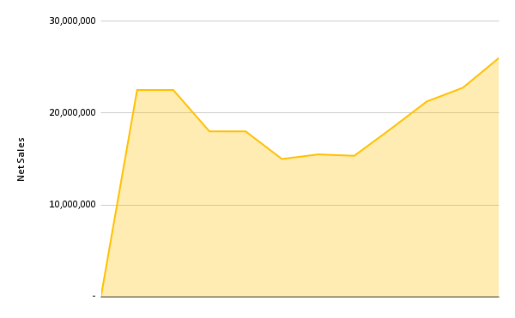
Sales Forecast
Net Sales | $215,100,000
Net Sales

Slide 13
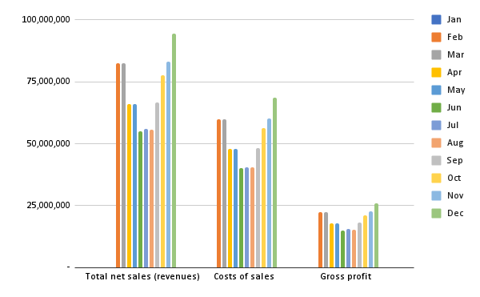
Income Projection Statement
Revenue Projected | Annual Total
Total net sales (revenues) | 785,200,000
Costs of sales | 570,100,000
Gross profit | 215,100,000
Revenue Projected within a year.

Slide 14
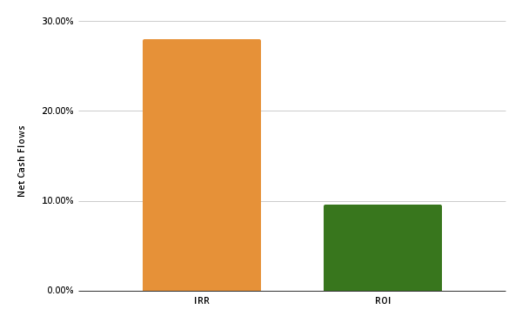
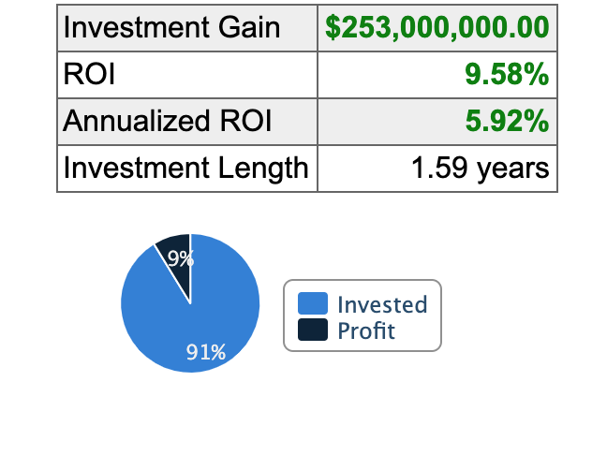
ROI & IRR
IRR | 28.03%
ROI | 9.58%
IRR and ROI

Slide 15
Conclusion
In other words, the project looks profitable!

Slide 16
Thanks!
Any questions?

